Slide 1
Sept 18, 2013 Staff Meeting
Addition of CCSS into Unit of Inquiry to make it transdiciplinary

Slide 2
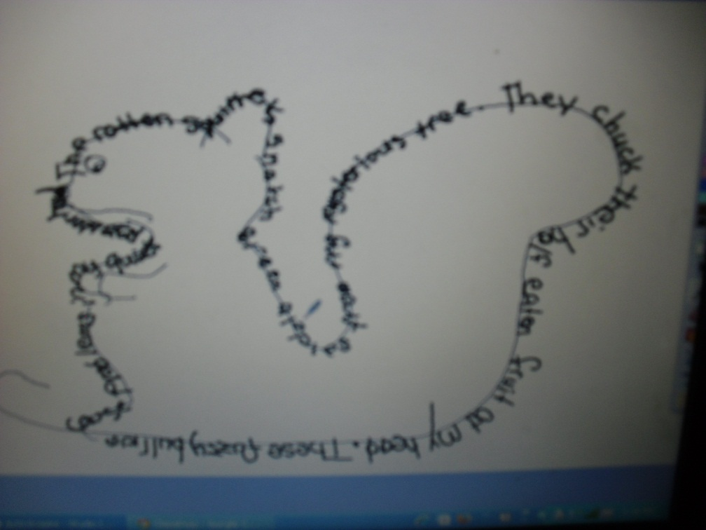
How we Express Ourselves Poetry
I can use descriptive language to write about an item found in nature. I will use a camera organizer to focus on the object.

Slide 3
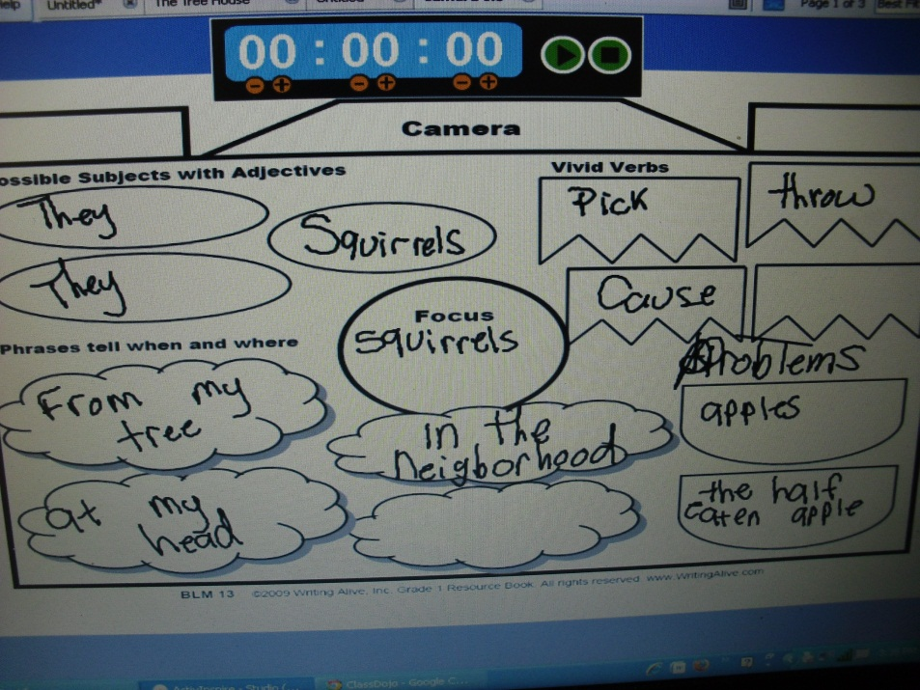
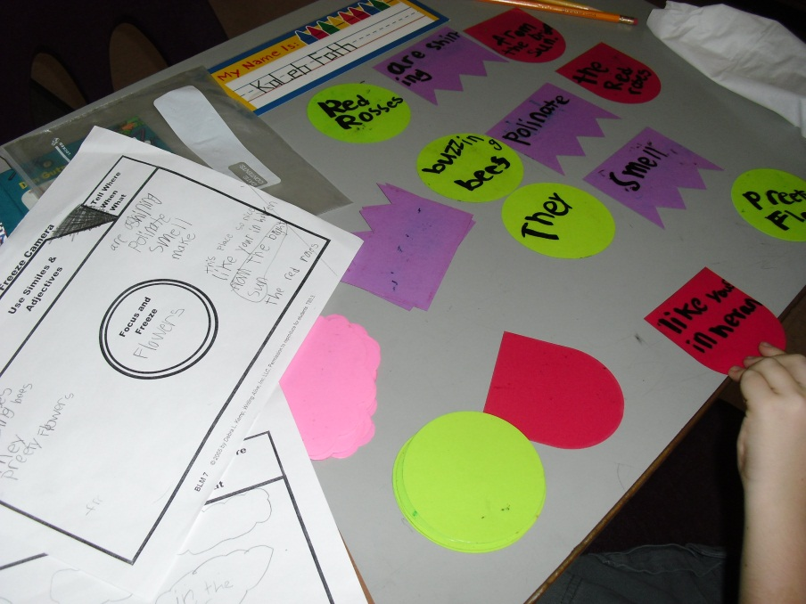
CCSS.ELA-Literacy.W.3.5 With guidance and support from peers and adults, develop and strengthen writing as needed by planning, revising, and editing.
Planning

Slide 4
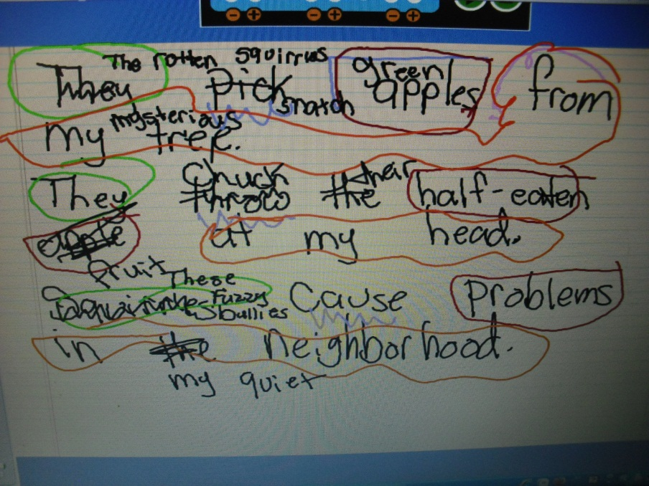
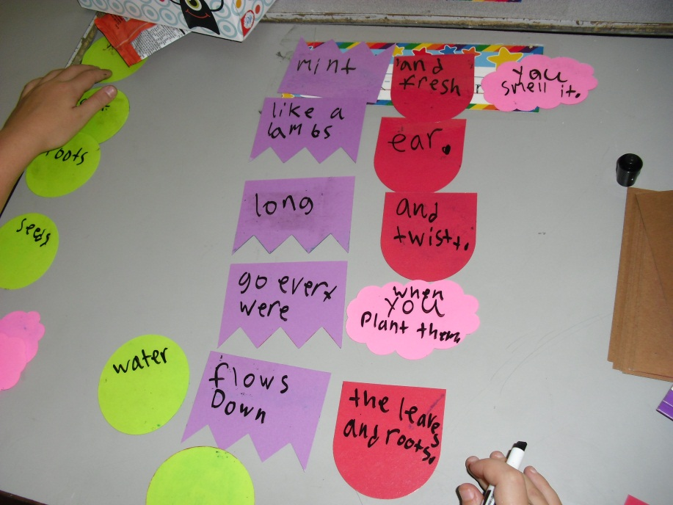
CCSS.ELA-Literacy.W.3.5 With guidance and support from peers and adults, develop and strengthen writing as needed by planning, revising, and editing.
Revising & Editing

